Slide 1
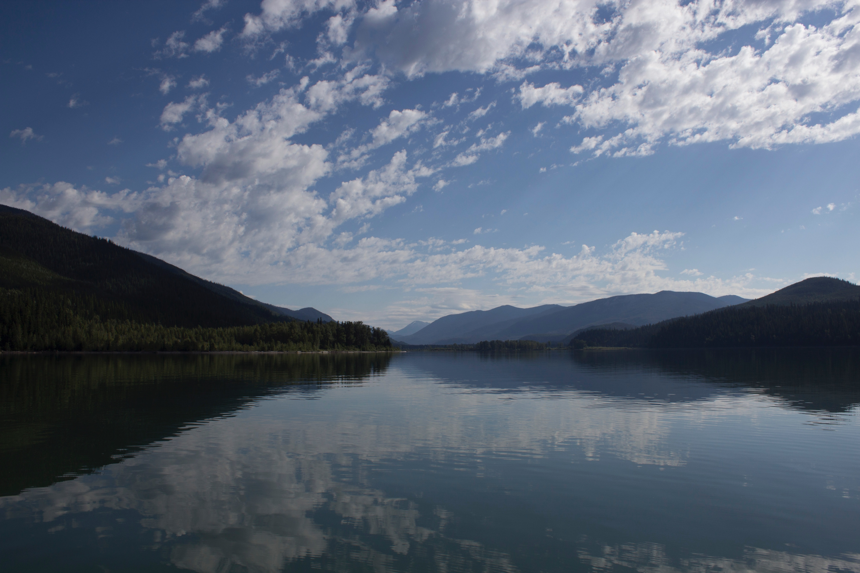
The Glaciolacustrine Sediment Record of Cariboo Lake, BC: Implications for Late Holocene Fluvial and Glacial Watershed Dynamics
Alex Cebulski & Dr. Joe Desloges
Notes:
Introduce self
Good afternoon everyone, today I will be presenting some research myself and joe Desloges completed on the sediment record of glacier-fed Cariboo Lake in british Columbia and the linkage between sediment accumulation and past climate changes.
Timings:
13:55.35 , a bit rushed.
2:26:00

Slide 2
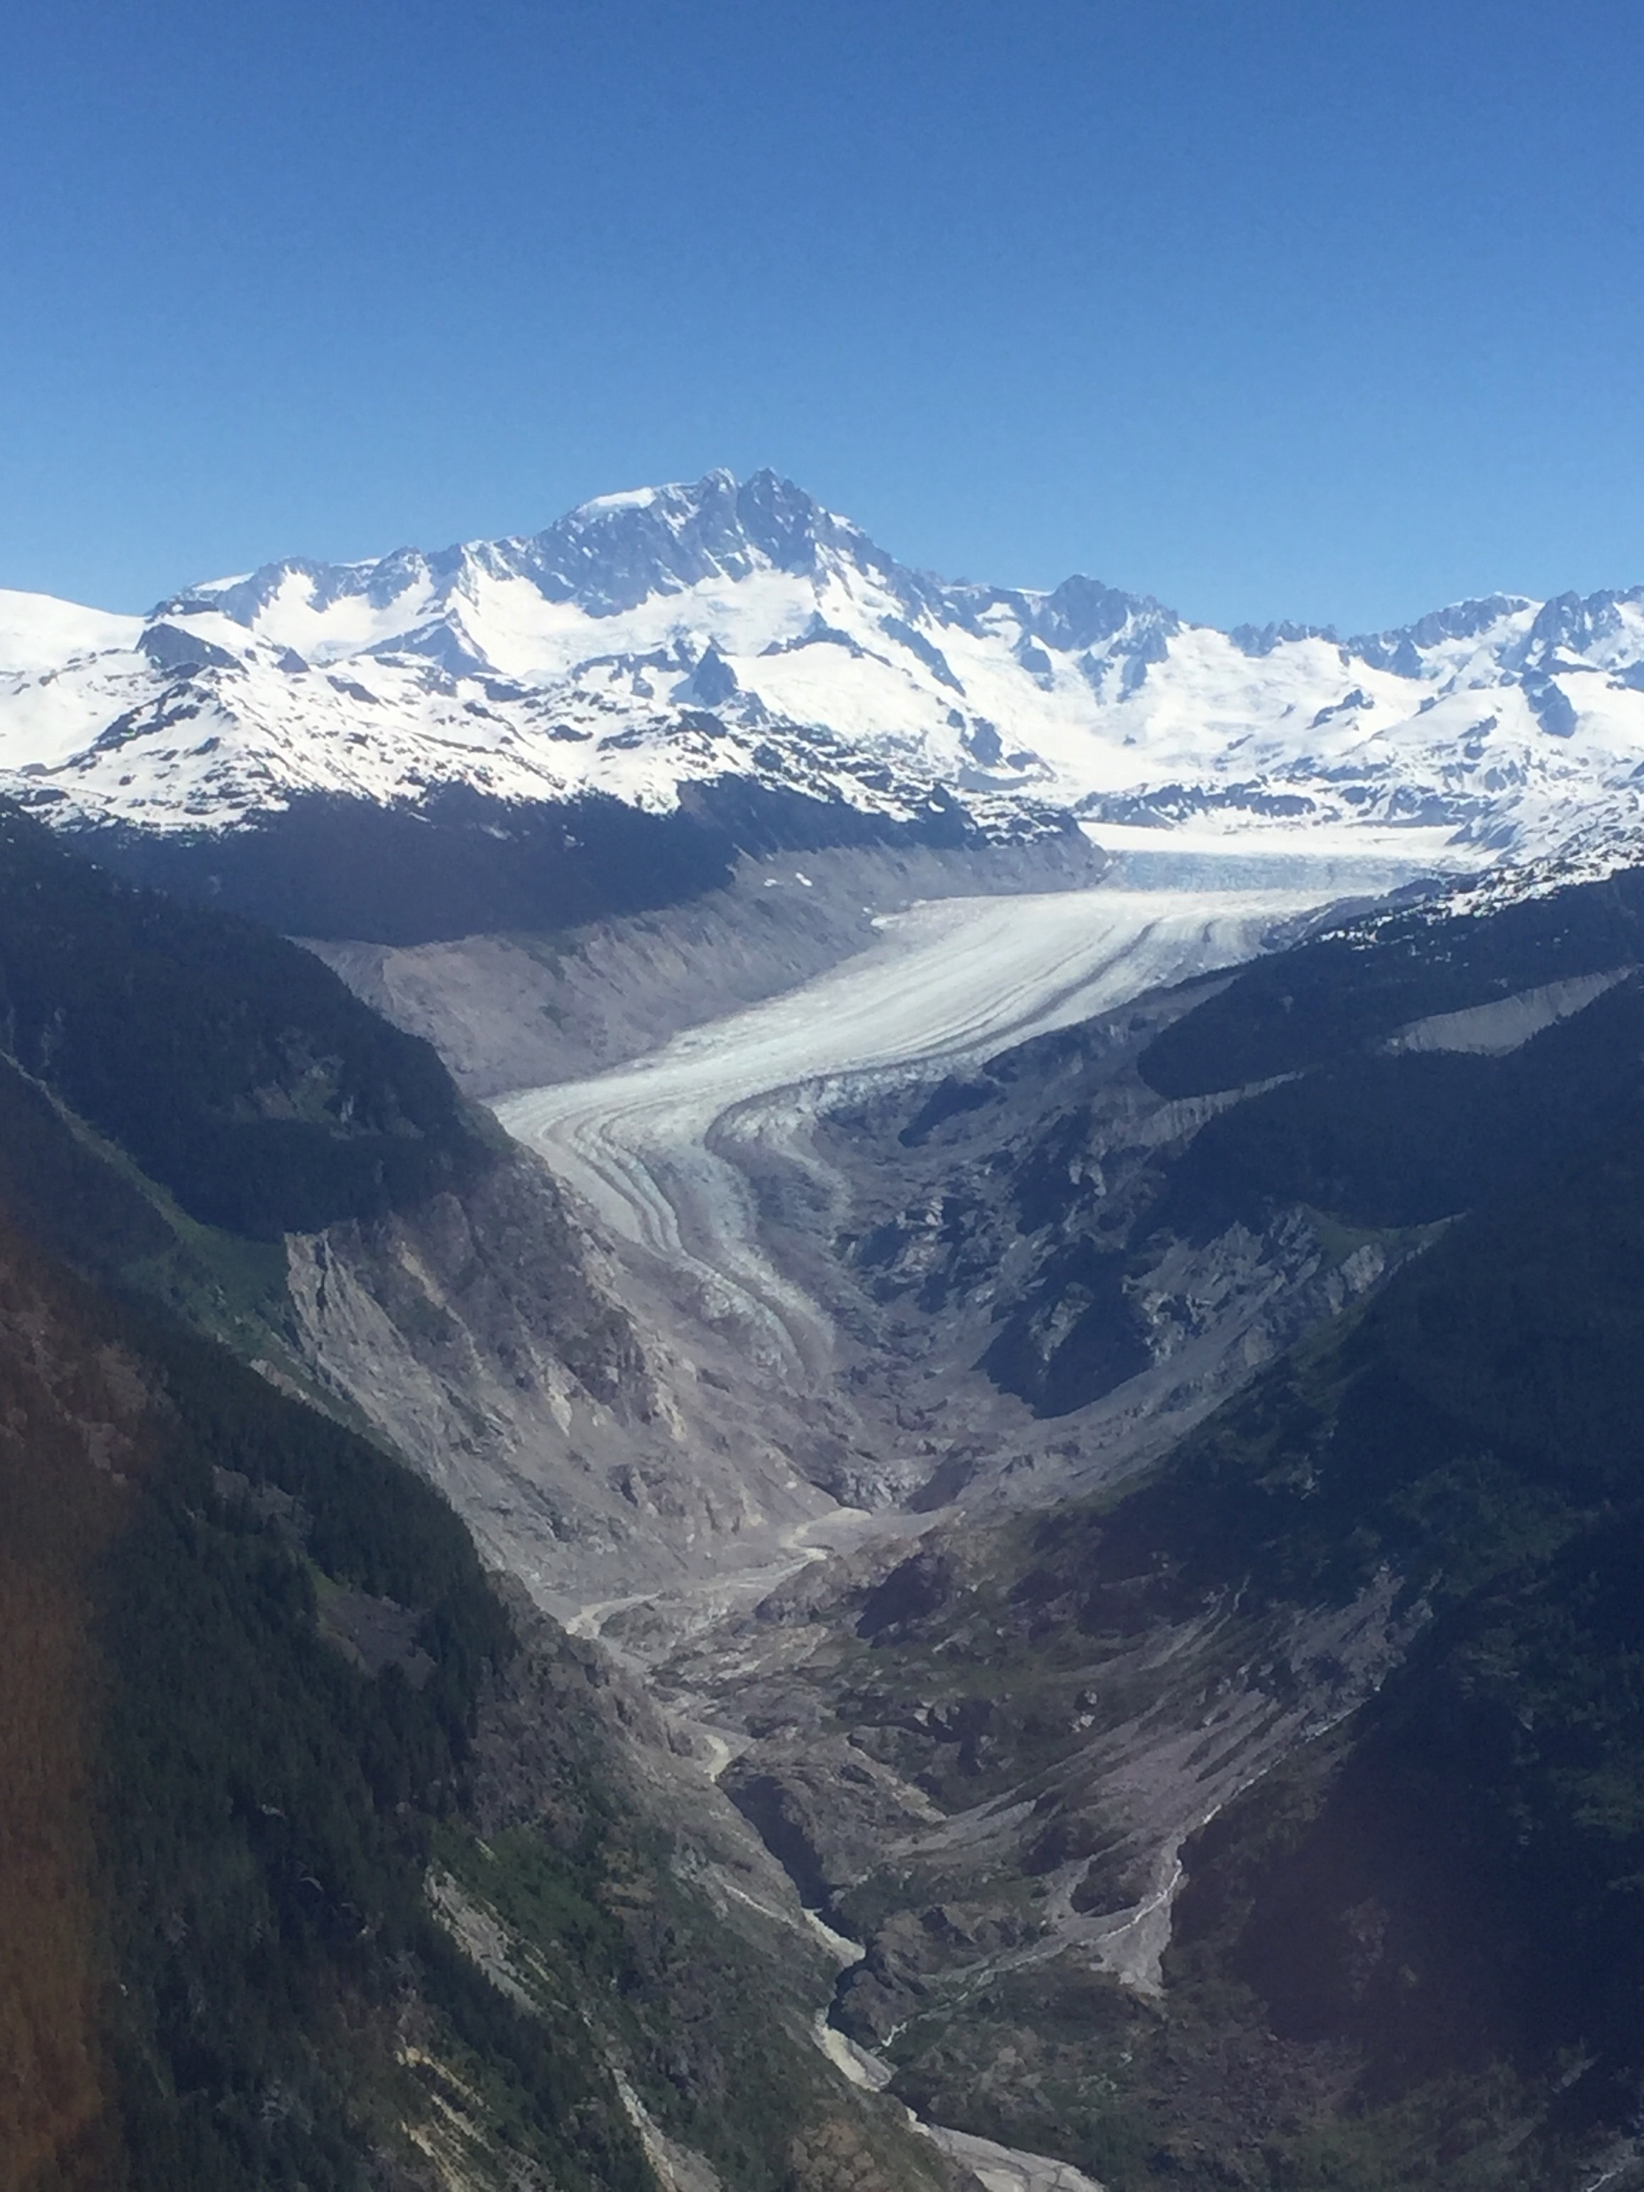
Background
Alpine environments & climate change
Changes Include:
Volume & area of glacier extent
The production, connectivity, and delivery of sediment
Environmental proxies in glaciated watersheds
Ice cores
Dating of material in glacier forefields
Glaciolacustrine sediment cores
Notes:
Glaciated alpine environments are particularly sensitive to changes in climate
Often these areas are the first to respond to T + P
Some of these changes include adjustments in the volume and area of glaciers, and the production, connectivity and delivery of sediment.
Researchers have been interested in these changes to gain a better understanding of how these environments respond to various changes in climate.
These studies utilize a variety of environmental proxies to understand these past changes.
These include: Ice cores, Dating of material in glacier forefields, and glaciolacustrine sediment cores
Which is the focus of our research. These cores are also known as glacier fed lake sediment records.

Slide 3
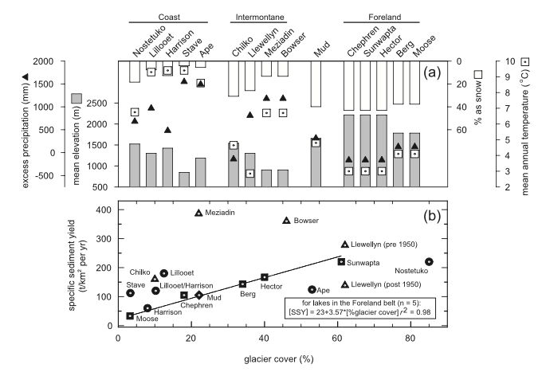
Background
Regional climate comparison of various glaciolacustrine sediment study sites
(Doughty et al., 1997)
(Rockies)
(Hodder et al., 2006)
Notes:
Several studies have utilized glacier-fed sediment records across western Canada with the goal of establishing a linkage between past climate change and sediment transport.
These studies are often grouped into the coastal, interior, and foreland (or rockies). These three regions are characterized by different climate regimes
In the coastal and rockies regions we can see patterns of precipitation and temperature are a bit more consistent across the various study sites within each respective group.
However, In the interior there is more variability in precipitation and temperature patterns
Therefore more research is required in the interior region to better represent the more variable climate and better understand the sediment – climate linkages in this region.

Slide 4
Background
Regional climate comparison of various glaciolacustrine sediment study sites
(Doughty et al., 1997)
(Rockies)
(Hodder et al., 2006)
Notes:
In the coastal and rockies regions we can see patterns of precipitation and temperature are a bit more consistent across the various study sites within each respective group.
However, In the interior there is more variability in precipitation and temperature patterns
Therefore more research is required in the interior region to better represent the more variable climate and better understand the sediment – climate linkages in this region.

Slide 5
Background
Regional climate comparison of various glaciolacustrine sediment study sites
(Doughty et al., 1997)
(Rockies)
(Hodder et al., 2006)
Notes:
However, In the interior there is more variability in precipitation and temperature patterns
Therefore more research is required in the interior region to better represent the more variable climate and better understand the sediment – climate linkages in this region.

Slide 6
Purpose: To determine if the distal glacier-fed sediment record from Cariboo Lake provides a proxy of past geomorphic and hydroclimatic change
Objectives:
Determine the mechanisms that control the production, connection, and transport of sediment
Analyze the sediment record of Cariboo Lake and determine if it reflects changes in past watershed activity
Compare the Cariboo Lake sediment record to other regional climate proxies
Notes:
Purpose: To determine if the distal glacier-fed sediment record from Cariboo Lake provides a proxy of past geomorphic and hydroclimatic change Determine the mechanisms for the production, connection, and transport of sediment
Analyze the sediment record of Cariboo Lake and determine if it reflects changes in past watershed activity
Compare the Cariboo Lake sediment record to other regional climate proxies

Slide 7
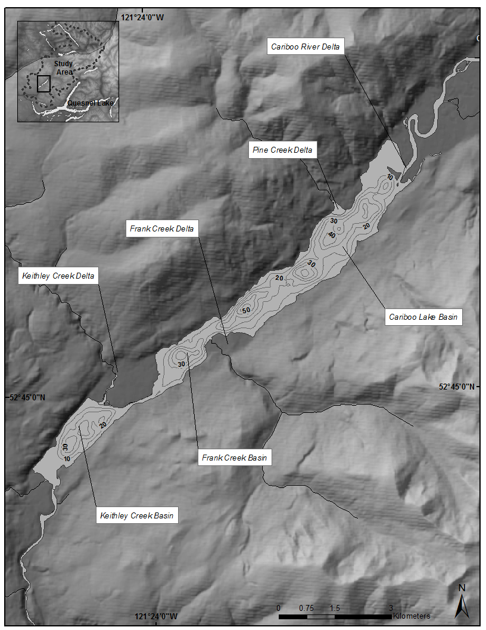
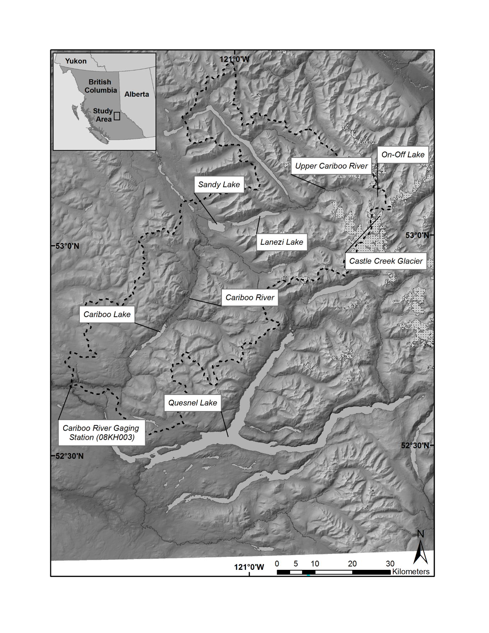
Study Site
Cariboo Lake, British Columbia
Notes:
Cariboo Lake, is located in Interior of British Columbia, in the Cariboo Mountains
The watershed area is characterized by 2.4% glacier cover which spans an area of 80 km².
*NEXT SLIDE* The cascade of sediment downvalley from the glaciated headwaters is significantly filtered by the deep fjord like Lanezi Lake basin which reaches a depth of 170 m
*NEXT SLIDE*
Cariboo Lake is locatd 85 km down-valley of headwater glacier activity
The Cariboo Lake bathymetry is fjord-like reaching a maximum water depth of 58 m.
The Cariboo River at the northeast end of the lake provides the primary input of sediment from the glaciated headwaters.
The Pine Creek, Frank Creek, and Keithley Creek deltas contribute additional sidewall sediment to the lake

Slide 8
Study Site
Cariboo Lake, British Columbia
Notes:
Cariboo Lake, is located in the Cariboo Mountains in east central bc.
The watershed area is characterized by 2.4% glacier cover which spans an area of 80 km². These glaciers are located 85 km up-valley of cariboo lake.
The cascade of sediment downvalley from these glaciated headwaters is largely filtered by the deep fjord like Lanezi Lake basin which reaches a depth of 170 m
The Cariboo Lake bathymetry is fjord-like reaching a maximum water depth of 58 m.
The Cariboo River at the northeast end of the lake provides the primary input of sediment from the glaciated headwaters.
The Pine Creek, Frank Creek, and Keithley Creek deltas contribute additional sidewall sediment to the lake

Slide 9
Study Site
Cariboo Lake, British Columbia
Notes:
Cariboo Lake, is located in the Cariboo Mountains in east central bc.
The watershed area is characterized by 2.4% glacier cover which spans an area of 80 km². These glaciers are located 85 km up-valley of cariboo lake.
The cascade of sediment down-valley from these glaciated headwaters is largely filtered by the deep fjord like Lanezi Lake basin which reaches a depth of 170 m
The Cariboo Lake bathymetry is fjord-like reaching a maximum water depth of 58 m.
The Cariboo River at the northeast end of the lake provides the primary input of sediment from the glaciated headwaters.
The Pine Creek, Frank Creek, and Keithley Creek deltas contribute additional sidewall sediment to the lake

Slide 10
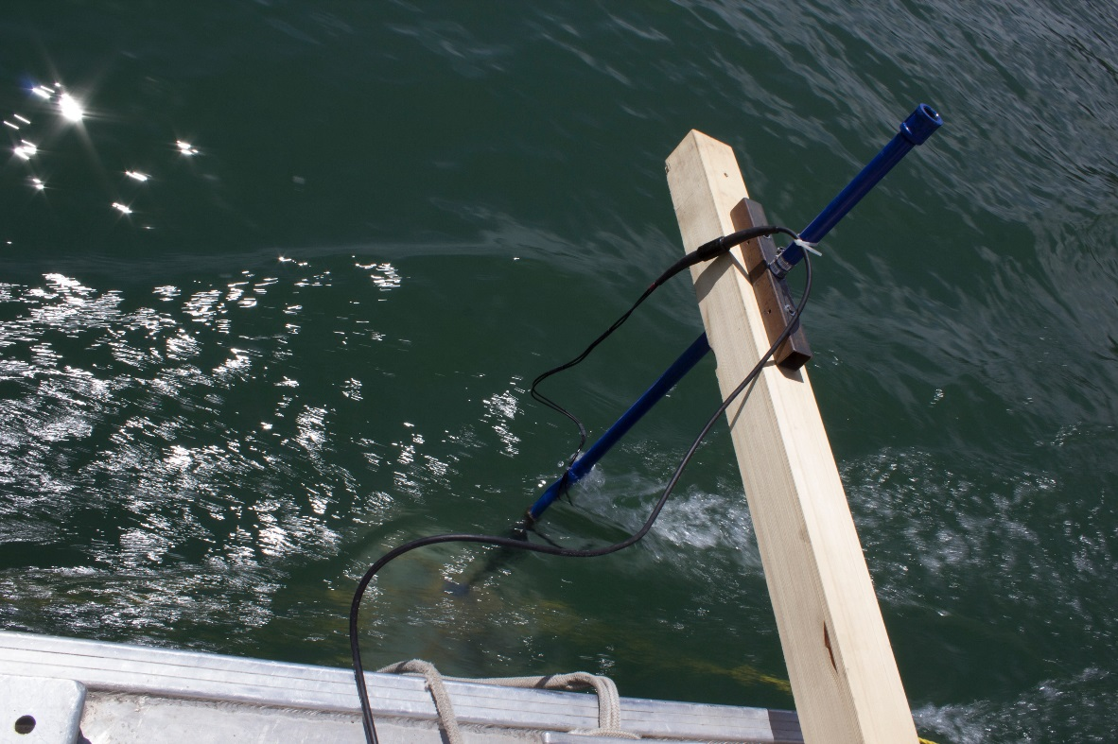
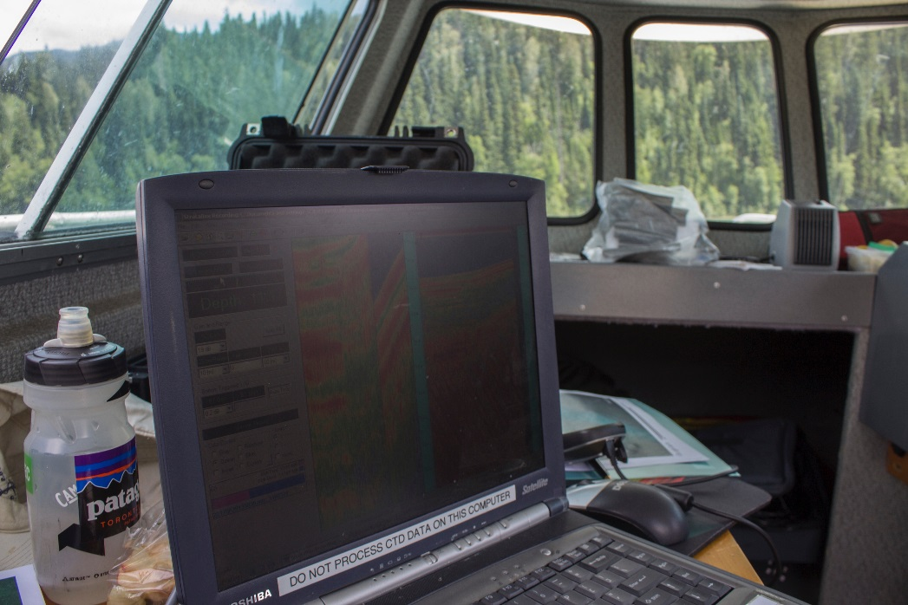
Methods
Sub-Bottom Acoustic Survey
Notes:
To analyze the Cariboo Lake sediment stratigraphy
A sub-bottom acoustic survey provided a coarse resolution representation of the cariboo lake Holocene sediment stratigraphy
Water column analyses including temperature and turbidity provided information about the stratigraphy of the lake water column and potential mechanisms for sediment inflow.
Ekman short cores were analyzed for laminae thickness, organic content, and sediment grain diameter which indicated how sediment delivery varied spatially across the lake
The Long Vibrocores were also analyzed for laminae thickness, organic content, and grain size diameter which provided a record of how sediment delivery changed through time.
AMS radiocarbon dates were analyzed on twigs to confirm our hypothesis that the sediment laminae were annual in nature.

Slide 11
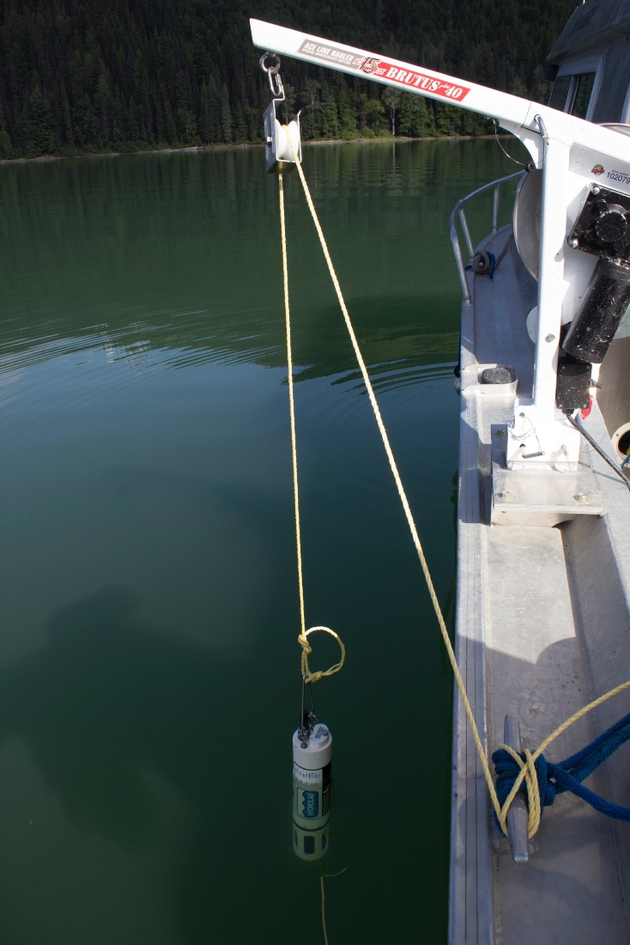
Methods
Sub-Bottom Acoustic Survey
CTD water column characteristics
Notes:
To analyze the Cariboo Lake sediment stratigraphy
A sub-bottom acoustic survey provided a coarse resolution representation of the cariboo lake Holocene sediment stratigraphy
Water column analyses including temperature and turbidity provided information about the stratigraphy of the lake water column and potential mechanisms for sediment inflow.
Ekman short cores were analyzed for laminae thickness, organic content, and sediment grain diameter which indicated how sediment delivery varied spatially across the lake
The Long Vibrocores were also analyzed for laminae thickness, organic content, and grain size diameter which provided a record of how sediment delivery changed through time.
AMS radiocarbon dates were analyzed on twigs to confirm our hypothesis that the sediment laminae were annual in nature.

Slide 12
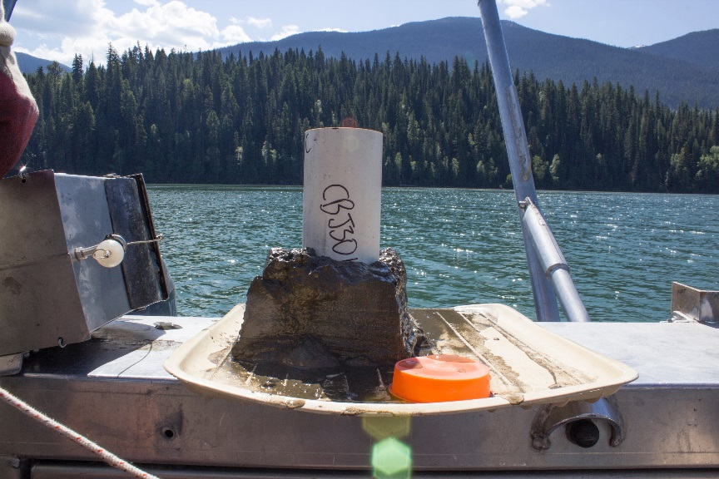
Methods
Sub-Bottom Acoustic Survey
CTD water column characteristics
20 Ekman surficial cores (~10 cm length)
Laminae thickness measurements
Organic content
Sediment grain diameter
Provide a spatial record
Notes:
To analyze the Cariboo Lake sediment stratigraphy
A sub-bottom acoustic survey provided a coarse resolution representation of the cariboo lake Holocene sediment stratigraphy
Water column analyses including temperature and turbidity provided information about the stratigraphy of the lake water column and potential mechanisms for sediment inflow.
Ekman short cores were analyzed for laminae thickness, organic content, and sediment grain diameter which indicated how sediment delivery varied spatially across the lake
The Long Vibrocores were also analyzed for laminae thickness, organic content, and grain size diameter and provided a record of how sediment delivery changed through time.
AMS radiocarbon dates were analyzed on twigs to confirm our hypothesis that the sediment laminae were annual in nature.

Slide 13
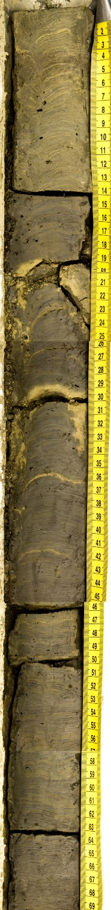
Methods
Sub-Bottom Acoustic Survey
CTD water column characteristics
20 Ekman dredge cores (~ 10 cm length)
Laminae thickness measurements
Organic content
Sediment grain diameter
Provide a spatial record
4 Vibracores (~ 4 m length)
Laminae thickness measurements
Organic content
Sediment grain diameter
AMS radiocarbon analysis
Provide a temporal record
V2 – (96 – 166 cm)
Notes:
To analyze the Cariboo Lake sediment stratigraphy
A sub-bottom acoustic survey provided a coarse resolution representation of the cariboo lake Holocene sediment stratigraphy
Water column analyses including temperature and turbidity provided information about the stratigraphy of the lake water column and potential mechanisms for sediment inflow.
Ekman short cores were analyzed for laminae thickness, organic content, and sediment grain diameter which indicated how sediment delivery varied spatially across the lake
The Long Vibrocores were also analyzed for laminae thickness, organic content, and grain size diameter which provided a record of how sediment delivery changed through time.
AMS radiocarbon dates were analyzed on twigs to confirm our hypothesis that the sediment laminae were annual in nature.

Slide 14
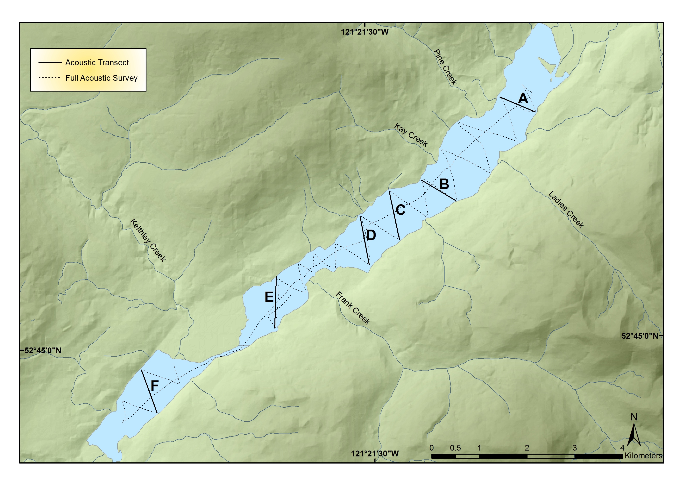
Results: Sub-Bottom Acoustics Transects
Notes:
Thirty four km of sub-bottom acoustic transects were conducted across the lake.
Near the Cariboo River delta at transect A there was no acoustic penetration
Transect B, C, and D resulted in the deepest acoustic penetration and thickest sediment packages.
Further down lake acoustic penetration became thinner and more variable.

Slide 15
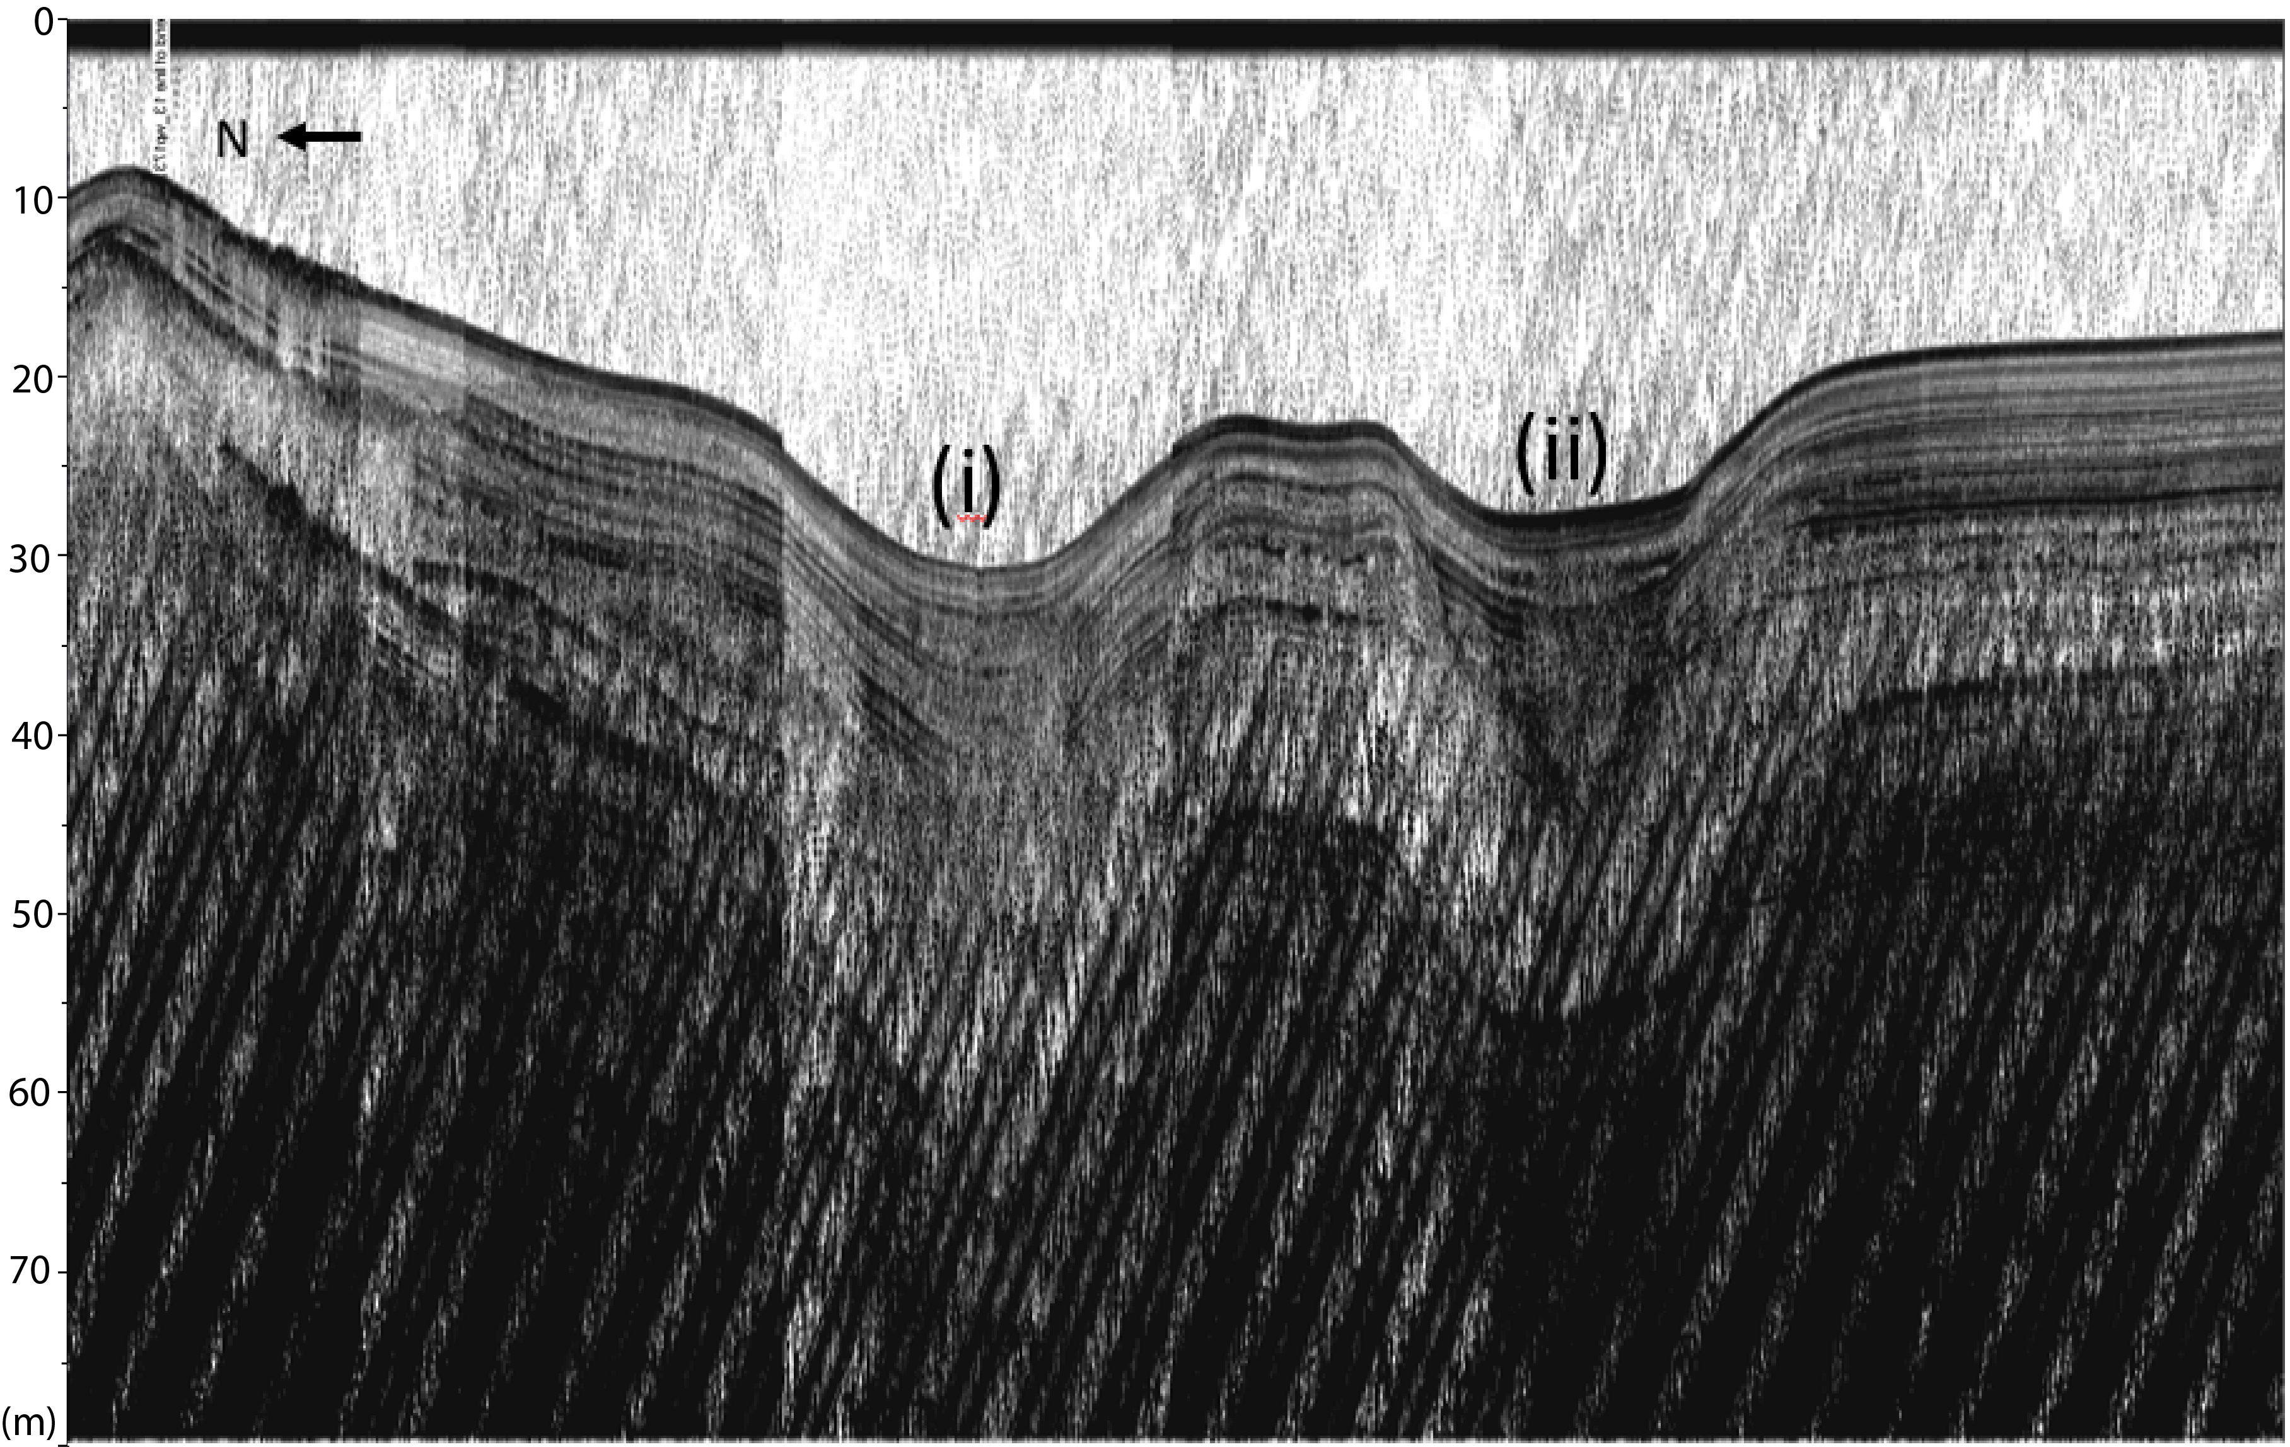
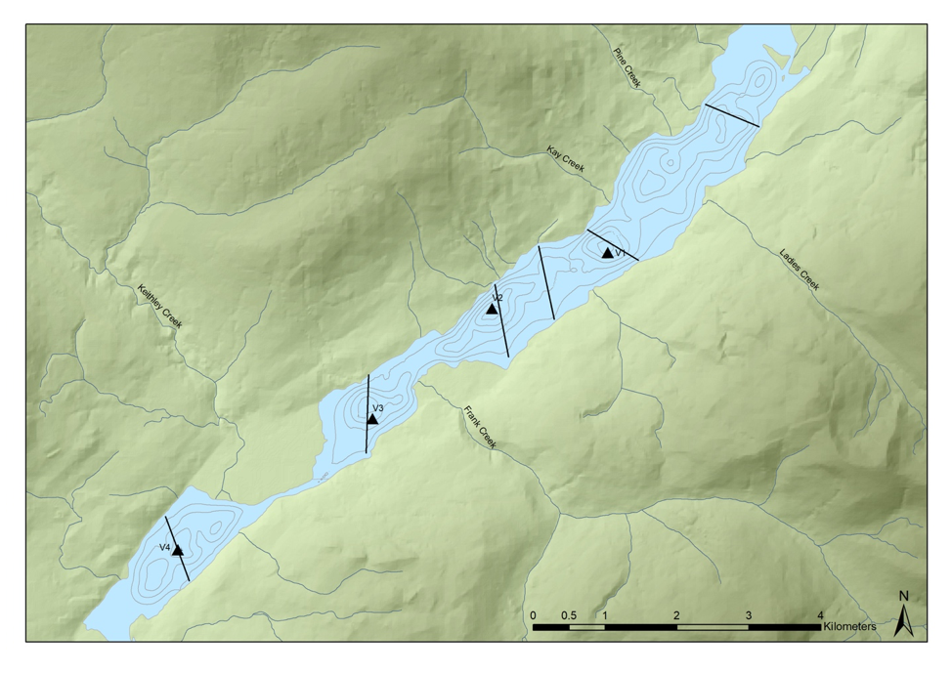
Sub-Bottom Acoustics: Transect C
(B)
18 m
(A)
(m)
Notes:
Transect C exhibits the most detailed record. Some cross hatching was observed on all acoustic records and was caused by electrical interference.
Two main sediment facies are observed here (A) & (B): Combined these layers are 18 m thick. It is estimated that these layers are representative of the last 9’000 years based on a 2 mm/yr sedimentation rate calculated from our sediment cores.
Facies A is Poorly laminated and lightly colored. This lack of lamination indicates a low energy Hypsithermal dry period with limited glacier cover leading to lower sedimentation rates.
Facies B indicates a resurgence of glaciers during an overall cooler period through acoustically laminated turbidity deposits.
These two facies coincide with the newly defined Holocene sub-sections. Facies A lines up with the Northgrippian period which spans from 8300 – 4200 BP. Facies B lines up with the Maghalayan which spans from 4200 yr BP to present.
The differences between the two scour channels are also interesting to note.
Scour channel 1 exhibits conformable laminations while scour channel 2 exhibits some disturbance in the bottom of facies B which could indicate a erosional deposit during neoglacial activity.

Slide 16
Sub-Bottom Acoustics: Transect C
(B)
(B)
18 m
(A)
(A)
(m)
Notes:
Transect C exhibits the most detailed record. Some cross hatching was observed on all acoustic records and was caused by electrical interference.
Two main sediment facies are observed here (A) & (B): Combined these layers are 18 m thick. It is estimated that these layers are representative of the last 9’000 years based on a 2 mm/yr sedimentation rate calculated from our sediment cores.
Facies A is Poorly laminated and lightly colored. This lack of lamination indicates a low energy Hypsithermal dry period with limited glacier cover leading to lower sedimentation rates.
Facies B indicates a resurgence of glaciers during an overall cooler period through acoustically laminated turbidity deposits.
These two facies coincide with the newly defined Holocene sub-sections. Facies A lines up with the Northgrippian period which spans from 8300 – 4200 BP. Facies B lines up with the Maghalayan which spans from 4200 yr BP to present.
The differences between the two scour channels are also interesting to note.
Scour channel 1 exhibits conformable laminations while scour channel 2 exhibits some disturbance in the bottom of facies B which could indicate a erosional deposit during neoglacial activity.

Slide 17
Sub-Bottom Acoustics: Transect C
(B)
(B)
18 m
(A)
(A)
North Grippian
~ 8300 – 4200 yr BP
(m)
Notes:
Transect C exhibits the most detailed record. Some cross hatching was observed on all acoustic records and was caused by electrical interference.
Two main sediment facies are observed here (A) & (B): Combined these layers are 18 m thick. It is estimated that these layers are representative of the last 9’000 years based on a 2 mm/yr sedimentation rate calculated from our sediment cores.
Facies A is Poorly laminated and lightly colored. This lack of lamination indicates a low energy Hypsithermal dry period with limited glacier cover leading to lower sedimentation rates.
Facies B indicates a resurgence of glaciers during an overall cooler period through acoustically laminated turbidity deposits.
These two facies coincide with the newly defined Holocene sub-sections. Facies A lines up with the Northgrippian period which spans from 8300 – 4200 BP. Facies B lines up with the Maghalayan which spans from 4200 yr BP to present.
The differences between the two scour channels are also interesting to note.
Scour channel 1 exhibits conformable laminations while scour channel 2 exhibits some disturbance in the bottom of facies B which could indicate a erosional deposit during neoglacial activity.

Slide 18
Sub-Bottom Acoustics: Transect C
Maghalayan
~ 4200 yr BP – pres.
(B)
(B)
18 m
(A)
(A)
North Grippian
~ 8300 – 4200 yr BP
(m)
Notes:
Transect C exhibits the most detailed record. Some cross hatching was observed on all acoustic records and was caused by electrical interference.
Two main sediment facies are observed here (A) & (B): Combined these layers are 18 m thick. It is estimated that these layers are representative of the last 9’000 years based on a 2 mm/yr sedimentation rate calculated from our sediment cores.
Facies A is Poorly laminated and lightly colored. This lack of lamination indicates a low energy Hypsithermal dry period with limited glacier cover leading to lower sedimentation rates.
Facies B indicates a resurgence of glaciers during an overall cooler period through acoustically laminated turbidity deposits.
These two facies coincide with the newly defined Holocene sub-sections. Facies A lines up with the Northgrippian period which spans from 8300 – 4200 BP. Facies B lines up with the Maghalayan which spans from 4200 yr BP to present.
The differences between the two scour channels are also interesting to note.
Scour channel 1 exhibits conformable laminations while scour channel 2 exhibits some disturbance in the bottom of facies B which could indicate a erosional deposit during neoglacial activity.

Slide 19
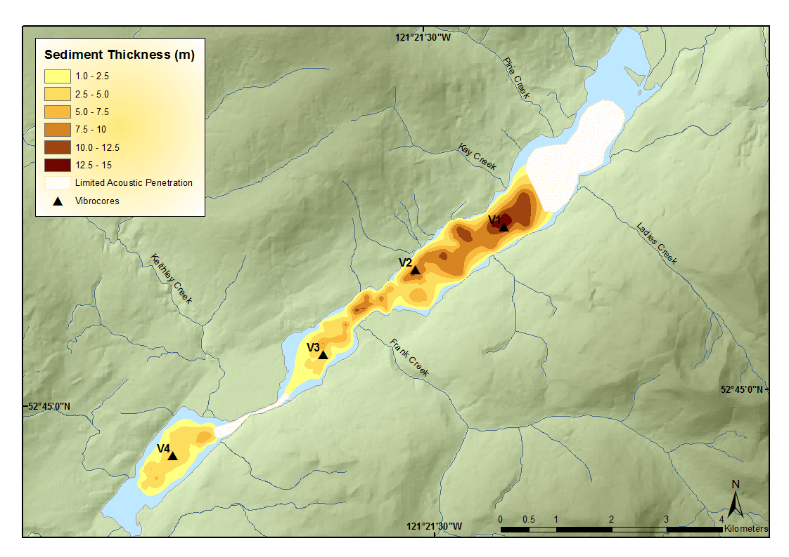
Sediment Thickness Map
Notes:
Here we derive a sediment thickness map from the acoustic sediment records. This illustrates the absence of acoustic penetration at the head of the lake and a decrease in sediment storage with distance downlake indicating that the main Cariboo River provides the dominant source of sediment to the lake.

Slide 20
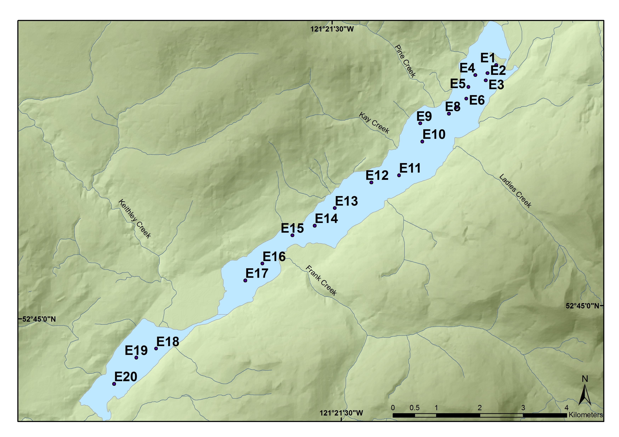
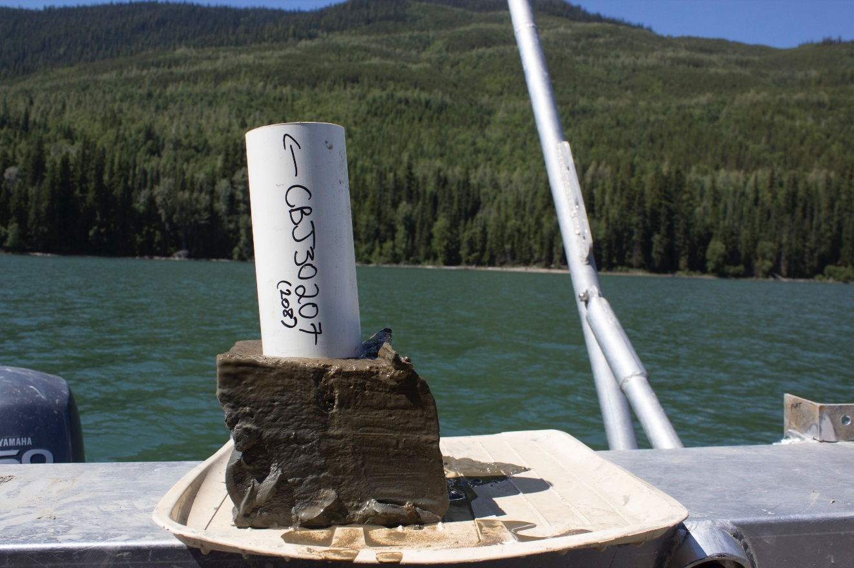
Ekman Surficial Sediment Record
Notes:
The 20 Ekman surficial Cores were collected along a Longitudinal transect down the deepest part of cariboo lake.

Slide 21
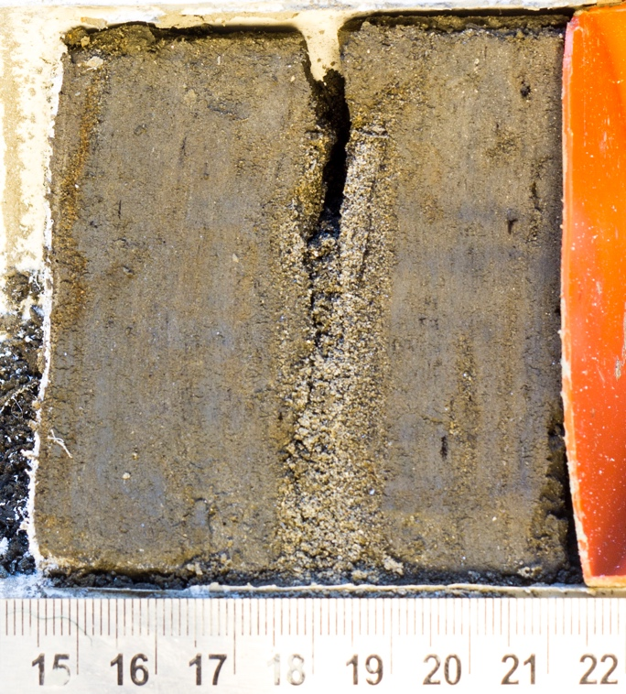
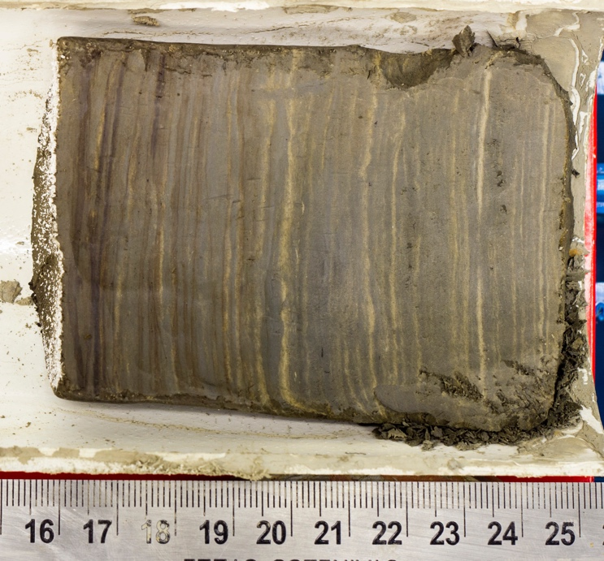
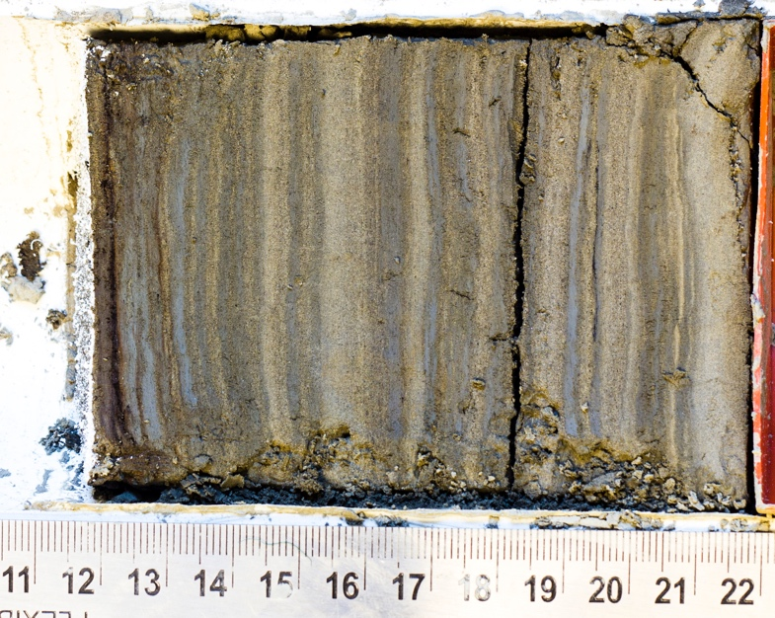
Ekman Cores
Main Cariboo Lake Basin
Frank Creek Basin
Keithley Creek Basin
Notes:
Photographs of the Ekman cores show Four main depositional environments down lake
1. Coarse grained sediments with Massive layering of sediments near Cariboo River
2. Laminated sediments further down lake in the Main Cariboo River Basin
3. Disturbed sediment laminae below the frank creek delta
4. Lighter, coarser grained laminations in the Keithley Creek Basin

Slide 22
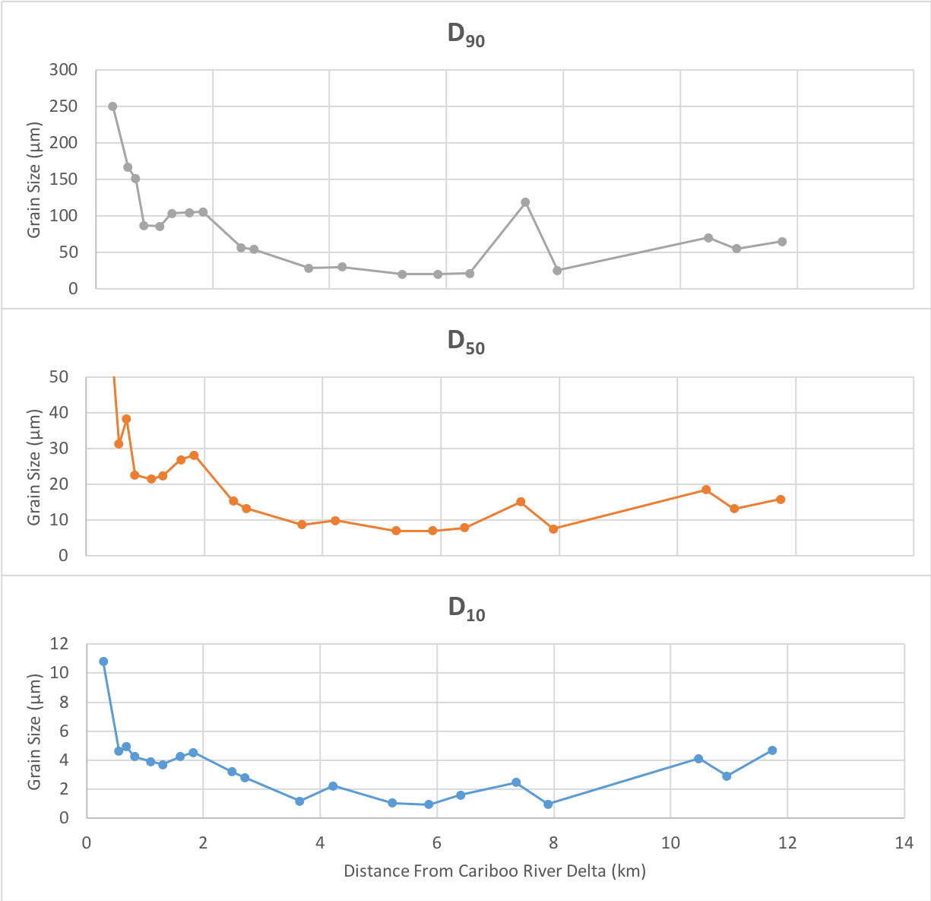
Ekman Grain Size Diameter
Cariboo River Basin
Keithley Creek Basin
Pine Creek Delta
Frank Creek Basin
Notes:
Out of the three Ekman sediment core analyses, Sediment grain diameter best illustrates the pattern of sediment delivery down-lake.
Exponential decline in sediment grain diameter with distance from the main Cariboo River delta supports findings from the sub-bottom acoustic record that the main Cariboo River provides the dominant input of sediment to the lake.
However down-lake there are some secondary sources of coarse grained sediment from the Frank Creek and Keithley Creek Deltas.
Distal from river deltas we see the majority of sediments delivered down-lake are silt and clay sized likely delivered from the cariboo river through suspended sediment transport

Slide 23
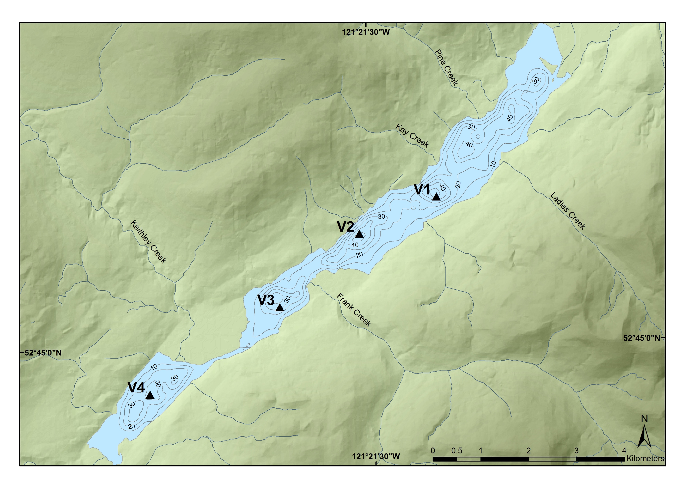
Vibra Core Location Map
Notes:
Of the four vibrocores collected, V1 and V2 collected in deep basins, furthest from secondary tributaries, provide the most well preserved sediment records
V3 and v4 were not as well preserved as they are located proximal to the frank creek and keithely creek delta which provide coarser sediment inputs and did not lead to clear laminations

Slide 24
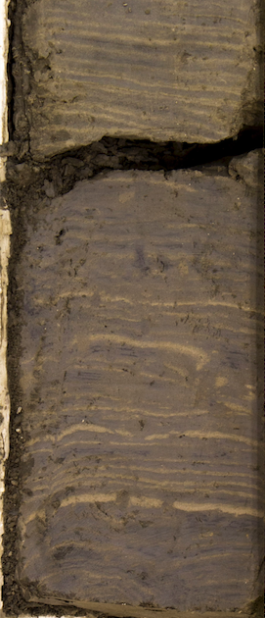
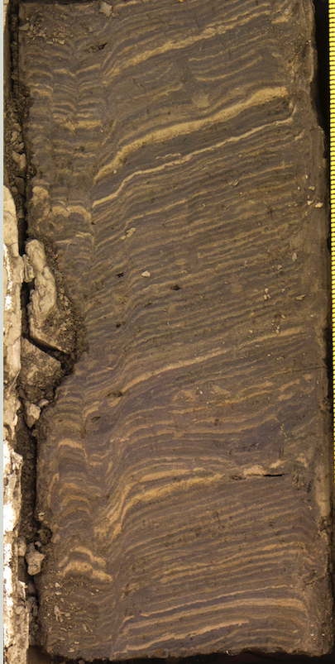
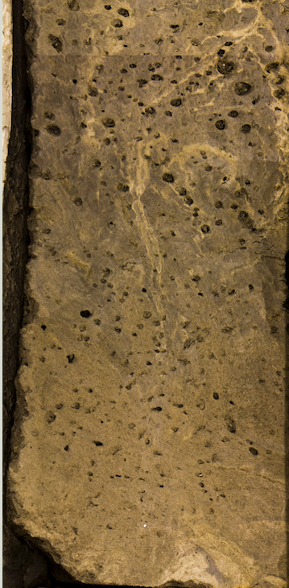
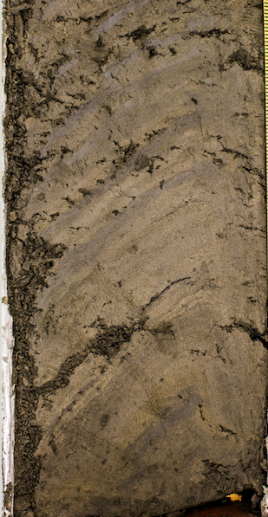
V1
Long Core Bottoms
V2
V3
V4
V1
V2
V3
V4
1 cm
1 cm
1 cm
1 cm
N. D.
N. D.
AD 450 - 525
AD 150 - 200
Distance From Cariboo River Delta (km)
3.75 | 5.50 | 7.55 | 10.75
Notes:
The stratigraphy of the long cores support findings from the Ekman surficial cores that there are three main depositional environments across Cariboo Lake.
Well laminated sediments in the main Cariboo Lake basin
Disturbed near the Frank Creek Delta
Lighter and coarser grained sediments in the Keithley creek basin

Slide 25
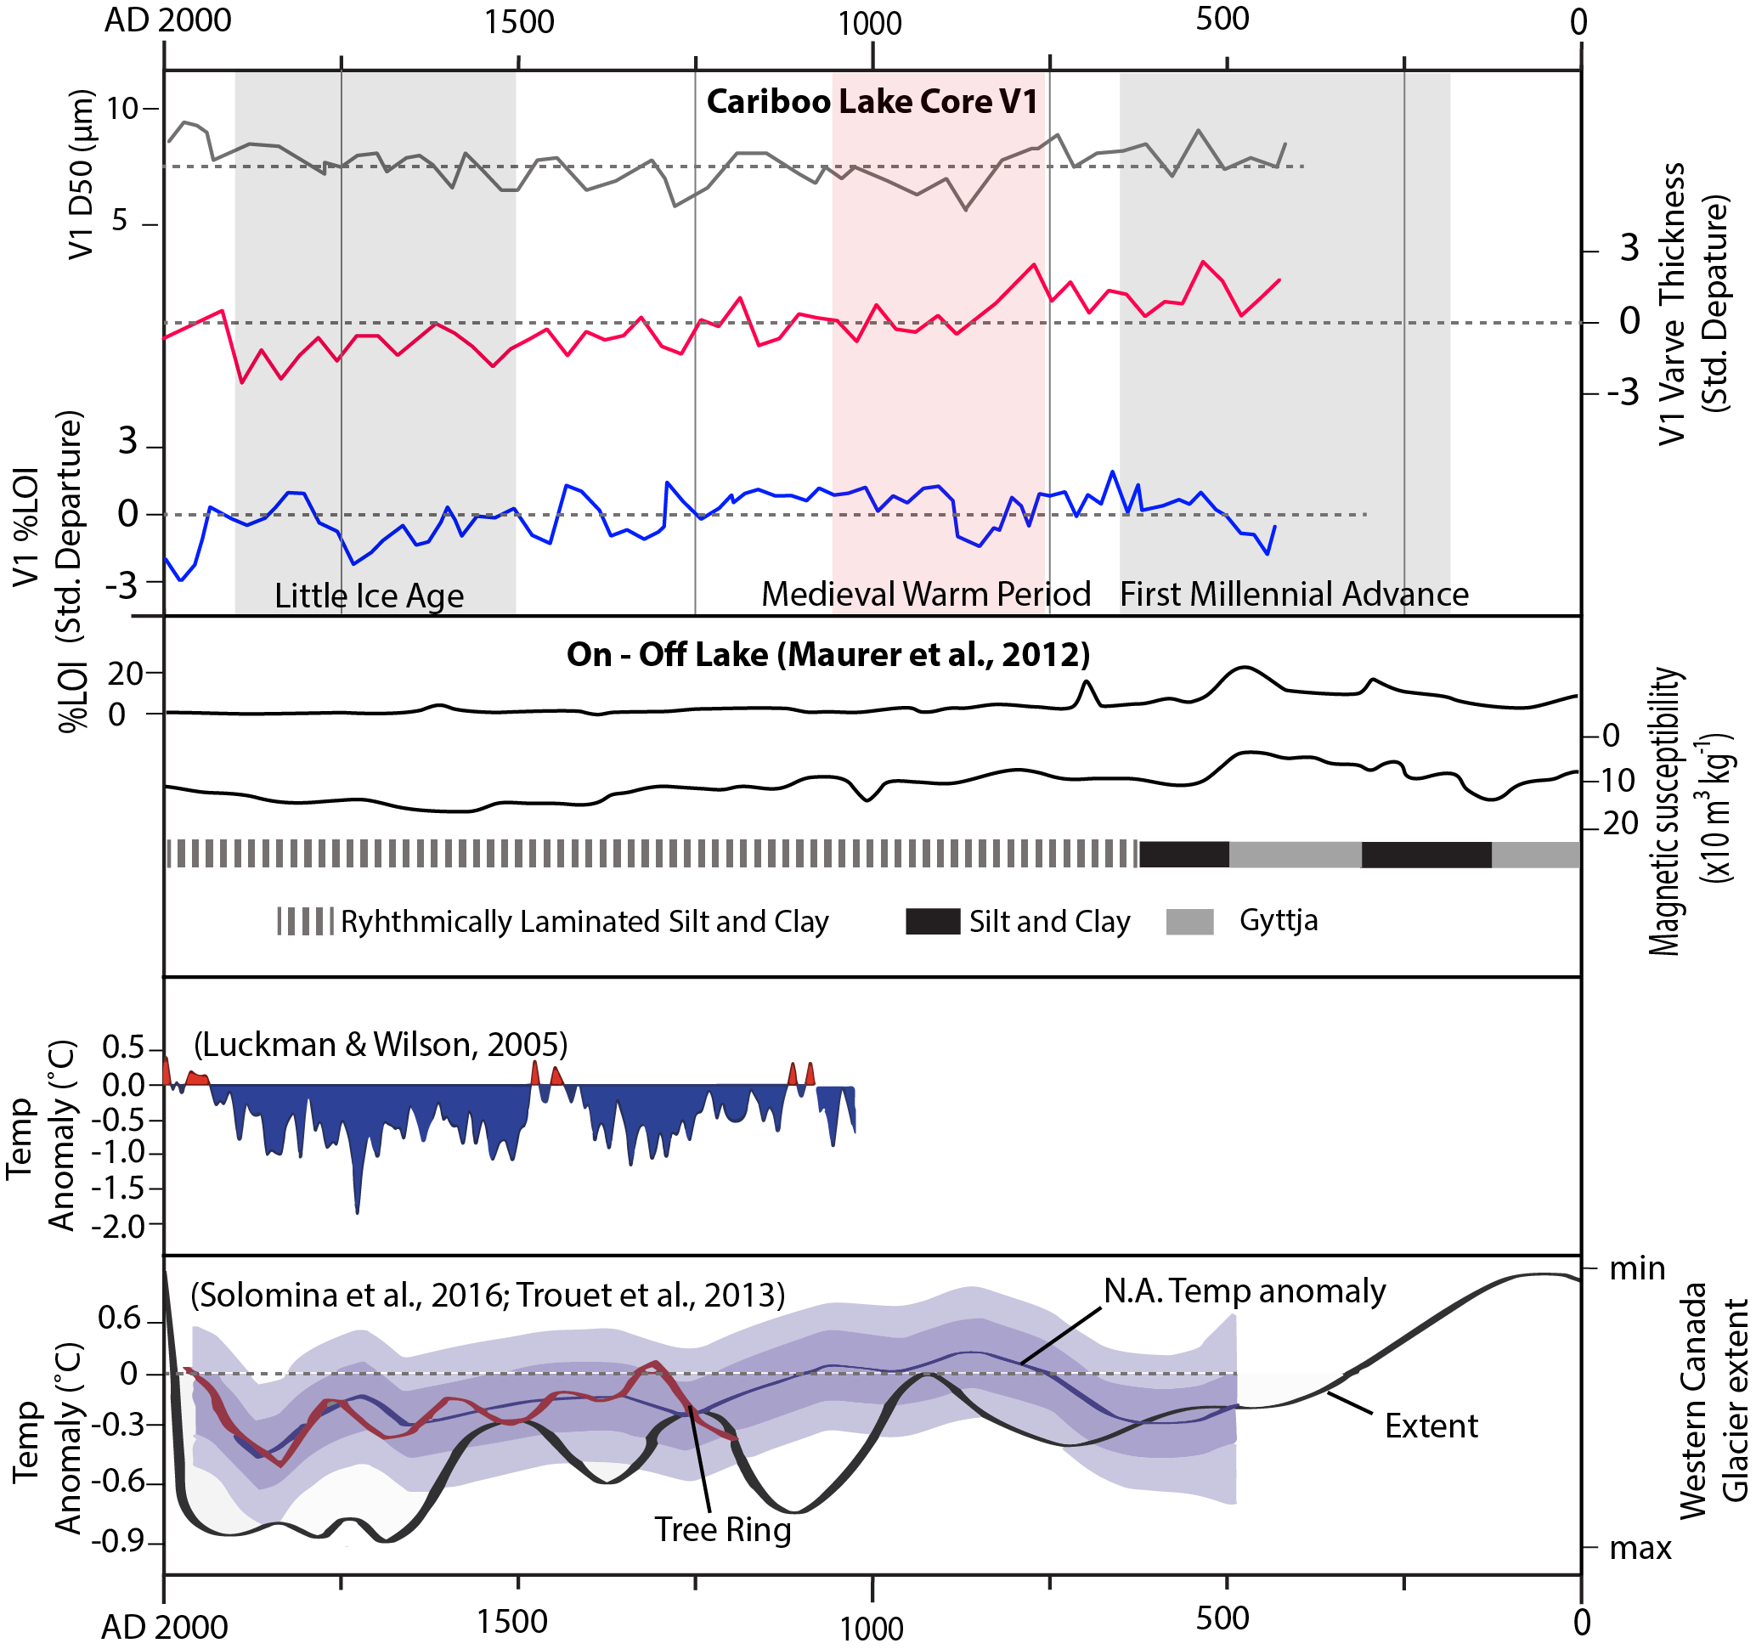
Regional Comparison
Notes:
Vibrocore one was chosen to compare to other regional climate records as it had the best preserved sediment record.
Records of grain size, varve thickness, and orgainic content from Vibro core 1 demonstrate changes in sediment delivery to cariboo lake over the past 1500 years.
This record of sediment yield exhibits some correlation to three climate fluctuations over the past 1500 years which are supported by other temperature proxies, glacier records and sediment yield studies across western Canada.
*NEXT SLIDE*
The vertical bars at the top denote these periods of climate fluctuation
First Millennial Advance around AD 200-700 was marked by a decrease in temperature and increase in glacier activity. IN the Cariboo Lake sediment record an increase to above average grain size and varve thickness is observed. Percent organics is slightly below average.
During the Medieval Warm Period AD 750-1100, The Cariboo Lake sediment single exhibits a decreasing trend in grain size and varve thickness and above average percent organics. This coincides with a period of above average temperature and decreased glacier extent
Lastly, during the Little Ice Age Advance (LIA) from AD 1500-1900, grain size exhibits a slight increasing trend and percent organics is slightly below average both indicating an increase in sediment yield. While varve thickness remains largely below average.
The sediment record from Cariboo Lake exhibits some correlation to the On-Off lake record (located in the Cariboo Lake watershed headwaters). In the on-off lake record they also exhibit a response to the First Millennial Advance and the Medieval Warm period but do not exhibit a strong signal during the Little Ice Age

Slide 26
Regional Comparison
Notes:
First Millennial Advance around AD 200-700 was marked by a decrease in temperature and increase in glacier activity. IN the Cariboo Lake sediment record an increase to above average grain size and varve thickness is observed. Percent organics is slightly below average. Which all point toward an increase in sediment yield during this time. *NEXT SLIDE*
During the Medieval Warm Period AD 750-1100, The Cariboo Lake sediment single exhibits a decreasing trend in grain size and varve thickness and above average percent organics. Indicates reduced sedimentation. This coincides with a period of above average temperature and decreased glacier extent. *NEXT SLIDE*
Lastly, during the Little Ice Age Advance (LIA) from AD 1500-1900, grain size exhibits a slight increasing trend and percent organics is slightly below average both indicating an increase in sediment yield. While varve thickness remains largely below average. *NEXT SLIDE*
The sediment record from Cariboo Lake exhibits some correlation to the On-Off lake record (located in the Cariboo Lake watershed headwaters). In the on-off lake record they also exhibit a response to the First Millennial Advance and the Medieval Warm period but do not exhibit a strong signal during the Little Ice Age

Slide 27
Regional Comparison
Notes:
First Millennial Advance around AD 200-700 was marked by a decrease in temperature and increase in glacier activity. IN the Cariboo Lake sediment record an increase to above average grain size and varve thickness is observed. Percent organics is slightly below average. Which all point toward an increase in sediment yield during this time. *NEXT SLIDE*
During the Medieval Warm Period AD 750-1100, The Cariboo Lake sediment single exhibits a decreasing trend in grain size and varve thickness and above average percent organics. Indicates reduced sedimentation. This coincides with a period of above average temperature and decreased glacier extent. *NEXT SLIDE*
Lastly, during the Little Ice Age Advance (LIA) from AD 1500-1900, grain size exhibits a slight increasing trend and percent organics is slightly below average both indicating an increase in sediment yield. While varve thickness remains largely below average. *NEXT SLIDE*
The sediment record from Cariboo Lake exhibits some correlation to the On-Off lake record (located in the Cariboo Lake watershed headwaters). In the on-off lake record they also exhibit a response to the First Millennial Advance and the Medieval Warm period but do not exhibit a strong signal during the Little Ice Age

Slide 28
Regional Comparison
Notes:
First Millennial Advance around AD 200-700 was marked by a decrease in temperature and increase in glacier activity. IN the Cariboo Lake sediment record an increase to above average grain size and varve thickness is observed. Percent organics is slightly below average. Which all point toward an increase in sediment yield during this time. *NEXT SLIDE*
During the Medieval Warm Period AD 750-1100, The Cariboo Lake sediment single exhibits a decreasing trend in grain size and varve thickness and above average percent organics. Indicates reduced sedimentation. This coincides with a period of above average temperature and decreased glacier extent. *NEXT SLIDE*
Lastly, during the Little Ice Age Advance (LIA) from AD 1500-1900, grain size exhibits a slight increasing trend and percent organics is slightly below average both indicating an increase in sediment yield. While varve thickness remains largely below average. *NEXT SLIDE*
The sediment record from Cariboo Lake exhibits some correlation to the On-Off lake record (located in the Cariboo Lake watershed headwaters). In the on-off lake record they also exhibit a response to the First Millennial Advance and the Medieval Warm period but do not exhibit a strong signal during the Little Ice Age

Slide 29
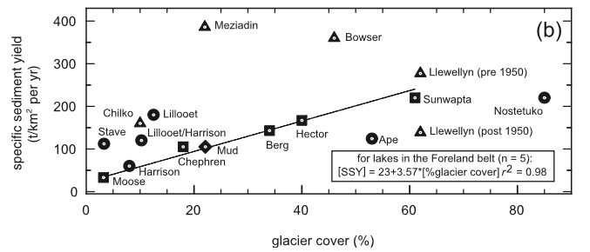
Sediment Yield Comparison
Legend
Coast
Intermontane
Omineca
(Hodder et al., 2006)
Foreland
Cariboo Lake:
6.35-7.59 Mg·km⁻²·a⁻¹
2.4% Perm. Snow Cover
Notes:
Looking at the distribution of sediment yield values across different proglacial lakes in western Canada we see
Cariboo Lake fits on the lower end of both percent glacier cover and sediment yield.
So the cariboo lake sediment record provides new information to a body of research that has primarily been focused on high sedimentation rates and glacier cover.
To Conclude
although the sediment accumulation rate in Cariboo Lake is low compared to these previous sites, delivery of suspended sediment from the glaciated headwaters has remained high enough to produce annual laminations over the past 1500 years.
Furthermore, our results demonstrate how geomorphic and hydroclimatic changes propagate down-valley from the glaciated headwaters which have far reaching affects in down stream societies.

Slide 30
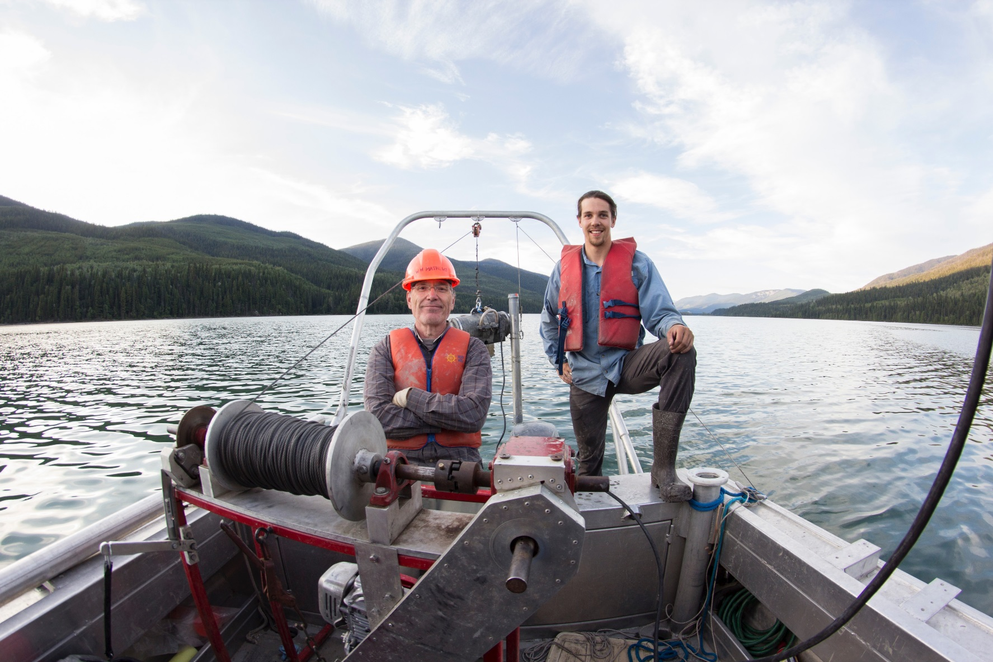
Thank you for your time!

Slide 31
Acknowledgements
Funding provided by the University of Toronto.
Lab assistance by Anna Soleski, Selina Amaral, Mike Gorton, George Kretschmann, and Yanan Liu at the University of Toronto.
Field support provided by Michael Allchin, Laszlo Enyedy, and Caitlin Langford at University of Northern British Columbia via the Quesnel River Research Centre.

